Slide 1
Statistical Data Analysis
Presented by:
Dipali Ziman
Batch 2021-6313

Slide 2
Abstract
This book is a guide to the practical application of statistics in data analysis as typically encountered in the physical sciences, and in particular in high energy particle physics.
It is assumed that the reader has an understanding of linear algebra, multi variable calculus and some knowledge of complex analysis. No prior knowledge of probability and statistics
The first part of the book covers basic concepts of probability and random variables, Monte Carlo techniques, statistical tests, and methods of parameter estimation.
The last somewhat more advanced than those preceding. It covers interval estimation, including the setting of limits on parameters,The characteristic function, problem of unfolding.

Slide 3
Introduction to Statistics
In its plural sense, statistics is a set of numerical data e.g. Vital statistics, monthly sales, exchange rates, etc.
In its singular sense, statistics is a branch of science that deals with the collection, presentation, analysis and interpretation of data.
General uses of Statistics in decision making by providing comparison of data, explains action that has taken place, justify a claim or assertion, predicts future outcome and estimates unknow quantities,summarizes data for public use.

Slide 4
Monte carlo Method
The Monte Carlo method is a numerical technique for calculating probabilities and related quantities by using sequences of random numbers.
It is a mathematical technique, which is used to estimate the possible outcomes of an uncertain event.

Slide 5
Statistical Hypothesis
A statistical hypothesis is an assertion or conjecture concerning one or more populations.
An assumption or statement, which may or may not be true concerning one or more population.
Two types of Statistical Hypothesis:
a) The NULL HYPOTHESIS, Ho
b) The ALTERNATIVE HYPOTHESIS, H1

Slide 6
Nondirectional Hypothesis– Asserts that one value is different from another (or others). Also called as the 2-sided Hypothesis. “Not equal to” or ≠.
Directional Hypothesis – An assertion that one measure is Less than (or greater than) another measure of similar nature. Also called the 1-sided Hypothesis. “<“ or “>”

Slide 7
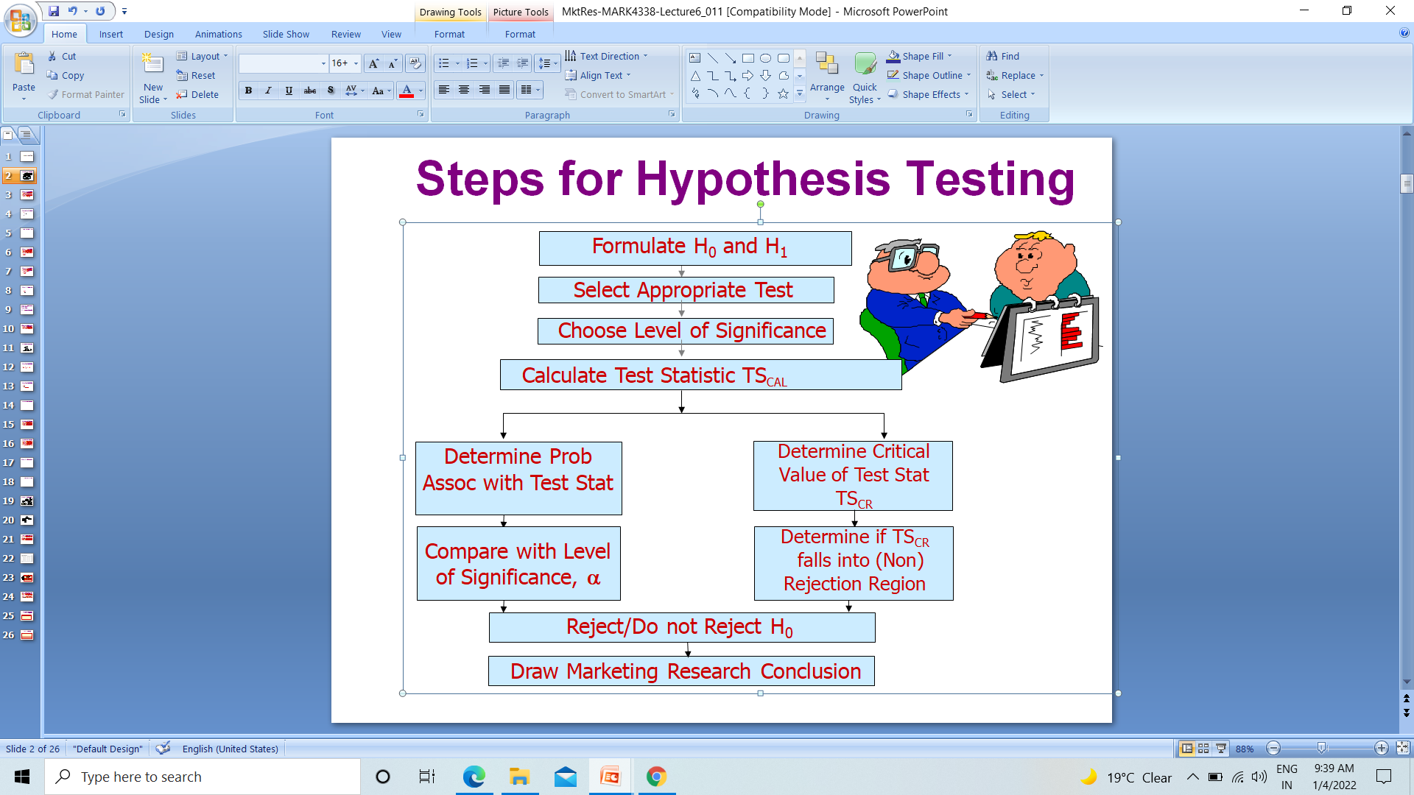
Steps for Hypothesis Testing

Slide 8
Formulate the Hypothesis
Select an Appropriate Test
Choose Level of Significance
Collect Data and Calculate Test Statistic
Determine Probability Value/Critical Value
Compare Prob and Make the Decision
Marketing Research Conclusion

